Slide 1
TAIEX AGP 64 485
Article 19 in regulation 1379/2013

Slide 2
Common Market Organisation
Article 19
Allocation of fishing opportunities
When performing its tasks, a producer organisation whose members are nationals of different Member States or an association of producer organisations recognised in different Member States shall comply with the provisions governing the allocation of fishing opportunities among Member States in accordance with Article 16 of Regulation (EU) No 1380/2013.

Slide 3
Fishing opportunities
Article 16 of Regulation No 1380/2013:
Fishing opportunities allocated to Member States shall ensure relative stability of fishing activities of each Member State for each fish stock or fishery. The interests of each Member State shall be taken into account when new fishing opportunities are allocated.
When the landing obligation in respect of a fish stock is introduced, fishing opportunities shall be fixed taking into account the change from fixing fishing opportunities that reflect landings to fixing fishing opportunities that reflect catches, on the basis of the fact that, for the first and subsequent years, discarding of that stock will no longer be allowed.

Slide 4
Article 16 of 1380/2013
Measures on the fixing and allocation of fishing opportunities available to third countries in Union waters shall be established in accordance with the Treaty.
Each Member State shall decide how the fishing opportunities that are allocated to it, and which are not subject to a system of transferable fishing concessions, may be allocated to vessels flying its flag (e.g. by creating individual fishing opportunities).
For the allocation of fishing opportunities pertaining to mixed fisheries, Member States shall take account of the likely catch composition of vessels participating in such fisheries.
Member States may, after notifying the Commission, exchange all or part of the fishing opportunities allocated to them.

Slide 5
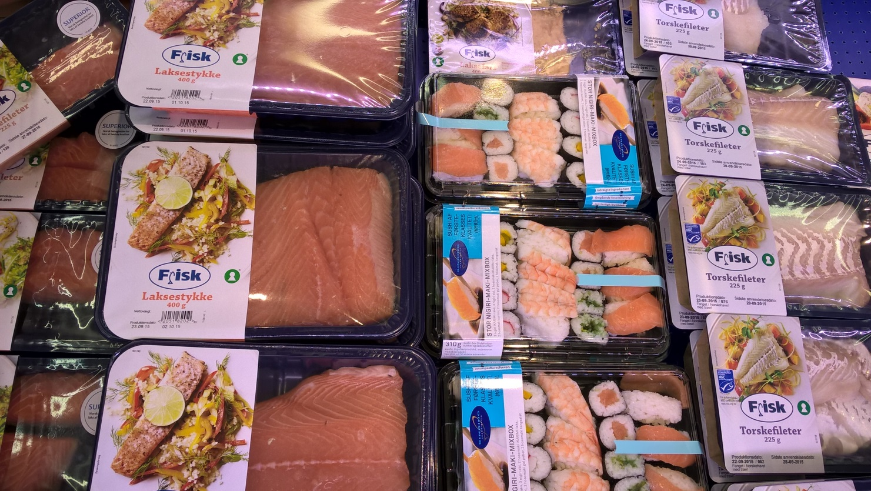
Time for questions!

Slide 6
TAIEX AGP 64 485
Council Regulations 1380/2013 on the Common Fisheries Policy article no 4 (sub; 4, 5, 6, 8, 9, 23, 24, 26, 27), article 16, 17, 19, 21, 22, 24 and related Council Regulation (EC) No 1224/2009

Slide 7
Article 4 - Definitions
'fishing vessel' means any vessel equipped for commercial exploitation of marine biological resources or a blue fin tuna trap;
'Union fishing vessel' means a fishing vessel flying the flag of a Member State and registered in the Union;
'entry to the fishing fleet' means registration of a fishing vessel in the fishing vessel register of a Member State;
‘precautionary approach to fisheries management', as referred to in Article 6 of the UN Fish Stocks Agreement, means an approach according to which the absence of adequate scientific information should not justify postponing or failing to take management measures to conserve target species, associated or dependent species and non-target species and their environment;

Slide 8
Article 4 - Definitions
'ecosystem-based approach to fisheries management' means an integrated approach to managing fisheries within ecologically meaningful boundaries which seeks to manage the use of natural resources, taking account of fishing and other human activities, while preserving both the biological wealth and the biological processes necessary to safeguard the composition, structure and functioning of the habitats of the ecosystem affected, by taking into account the knowledge and uncertainties regarding biotic, abiotic and human components of ecosystems;
'transferable fishing concession' means a revocable user entitlement to a specific part of fishing opportunities allocated to a Member State or established in a management plan adopted by a Member State, which the holder may transfer;

Slide 9
Article 4 - Definitions
'fishing capacity' means a vessel's tonnage in GT (Gross Tonnage) and its power in kW (Kilowatt) as defined in Articles 4 and 5 of Council Regulation (EEC) No 2930/86 ( 2 );
'fishing licence' means a licence as defined in point (9) of Article 4 of Council Regulation (EC) No 1224/2009 ( 1 );
'fishing authorisation' means an authorisation as defined in point (10) of Article 4 of Regulation (EC) No 1224/2009;

Slide 10
Article 17
Criteria for the allocation of fishing opportunities by Member States
When allocating the fishing opportunities available to them, Member States shall use transparent and objective criteria including those of an environmental, social and economic nature. The criteria to be used may include, inter alia, the impact of fishing on the environment, the history of compliance, the contribution to the local economy and historic catch levels. Within the fishing opportunities allocated to them, Member States shall endeavour to provide incentives to fishing vessels deploying selective fishing gear or using fishing techniques with reduced environmental impact, such as reduced energy consumption or habitat damage.

Slide 11
Article 19
Member State measures applicable to fishing vessels flying their flag or to persons established in their territory
A Member State may adopt measures for the conservation of fish stocks in Union waters provided that those measures fulfil all of the following requirements:
they apply solely to fishing vessels flying the flag of that Member State or, in the case of fishing activities which are not conducted by a fishing vessel, to persons established in that part of its territory to which the Treaty applies;
they are compatible with the objectives set out in Article 2;
they are at least as stringent as measures under Union law.
A Member State shall, for control purposes, inform the other Member States concerned of provisions adopted pursuant to paragraph 1.
Member States shall make publicly available appropriate information concerning the measures adopted in accordance with this Article.

Slide 12
Article 21
Establishment of systems of transferable fishing concessions
Member States may establish a system of transferable fishing concessions. Member States having such a system shall establish and maintain a register of transferable fishing concessions.

Slide 13
Article 22
Adjustment and management of fishing capacity
Member States shall put in place measures to adjust the fishing capacity of their fleet to their fishing opportunities over time, taking into account trends and based on best scientific advice, with the objective of achieving a stable and enduring balance between them.
In order to achieve the objective, Member States shall send to the Commission, by 31 May each year, a report on the balance between the fishing capacity of their fleets and their fishing opportunities. To facilitate a common approach across the Union, that report shall be prepared in accordance with common guidelines which may be developed by the Commission indicating the relevant technical, social and economic parameters.

Slide 14
Article 22
Adjustment and management of fishing capacity
The report shall contain the annual capacity assessment of the national fleet and of all fleet segments of the Member State. The report shall seek to identify structural overcapacity by segment and shall estimate the long-term profitability by segment. The reports shall be made publicly available.
If the assessment clearly demonstrates that the fishing capacity is not effectively balanced with fishing opportunities, the Member State shall prepare and include in its report an action plan for the fleet segments with identified structural overcapacity.

Slide 15
Article 22
Adjustment and management of fishing capacity
Failure to make the report and/or failure to implement the action plan referred, may result in a proportionate suspension or interruption of relevant Union financial assistance to that Member State for fleet investment in the fleet segment or segments concerned in accordance with a future Union legal act establishing the conditions for the financial support for maritime and fisheries policy for the period 2014–2020.
No exit from the fleet supported by public aid shall be permitted unless preceded by the withdrawal of the fishing licence and the fishing authorisations.
The fishing capacity corresponding to the fishing vessels withdrawn with public aid shall not be replaced.

Slide 16
Article 24
Fishing fleet registers
Member States shall record the information on ownership, on vessel and gear characteristics and on the activity of Union fishing vessels flying their flag that is necessary for the management of measures established under this Regulation.
Member States shall submit to the Commission the information referred to.
The Commission shall maintain a Union fishing fleet register containing the information that it receives. It shall provide public access to the Union fishing fleet register, while ensuring that personal data is adequately protected.

Slide 17
Regulation 1224/2009
Establishing a Union control system for ensuring compliance with the rules of the common fisheries policy

Slide 18
Article 6
Fishing licence
A Union fishing vessel may be used for commercial exploitation of living aquatic resources only if it has a valid fishing licence.
The flag Member State shall ensure that the information contained in the fishing licence is accurate and consistent with that contained in the Community fishing fleet register
The flag Member State shall suspend temporarily the fishing licence of a vessel which is subject to temporary immobilisation decided by that Member State or which has had its fishing authorisation suspended.

Slide 19
The flag Member State shall withdraw permanently the fishing licence of a vessel which is the subject of a capacity adjustment measure, or which has had its fishing authorisation withdrawn
The flag Member State shall issue, manage and withdraw the fishing licence in accordance with the detailed rules adopted.

Slide 20
Article 7
Fishing authorisation
A Union fishing vessel operating in Union waters shall be authorised to carry out specific fishing activities only insofar as they are indicated in a valid fishing authorisation when the fisheries or fishing zones where the activities are authorised are subject to:
(a) a fishing effort regime;
(b) a multiannual plan;
(c) a fishing restricted area;
(d) fishing for scientific purposes;
(e) other cases laid down in Union legislation.

Slide 21
Where a Member State has a specific national fishing authorisation scheme, it shall send to the Commission at its request a summary of the information contained in the authorisation issued and the related aggregated figures on fishing effort.
Where the flag Member State has adopted national provisions in the form of a national fishing authorisation scheme for the allocation to individual vessels of the fishing opportunities available to it, it shall send to the Commission at its request information on the fishing vessels authorised to engage in a fishing activity in a given fishery, in particular concerning the external identification number, the name of the fishing vessels concerned, and the individual fishing opportunities allocated to them.

Slide 22
A fishing authorisation shall not be issued if the fishing vessel concerned does not have a fishing licence obtained or if its fishing licence has been suspended or withdrawn.
A fishing authorisation shall be automatically withdrawn where the fishing licence corresponding to the vessel has been withdrawn permanently. It shall be suspended where the fishing licence has been suspended temporarily.

Slide 23
Regulation 404/2011
Article 3 - Issue and management of fishing licences
A fishing licence referred to in Article 6 of the Control Regulation shall be valid for one Union fishing vessel only.
Fishing licences referred to in Article 6 of the Control Regulation shall be issued, managed and withdrawn by Member States for their fishing vessels in accordance with this Regulation.
Fishing licences referred to in Article 6 of the Control Regulation shall contain as a minimum the information set out in Annex II.

Slide 24
Fishing licences issued in accordance with Regulation (EC) No 1281/2005 shall be considered as fishing licences issued in accordance with this Regulation if they contain the minimum information required by paragraph 3 of this Article.
A fishing licence shall only be valid if the conditions on the basis of which it has been issued are still met.
If a fishing licence has been temporarily suspended or permanently withdrawn, the authorities of the flag Member State shall immediately inform the holder of the fishing licence.

Slide 25
ANNEX II
MINIMUM INFORMATION FOR THE FISHING LICENCES
1. FISHING VESSEL DETAILS ( 1 )
Union fleet register number ( 2 )
Name of fishing vessel ( 3 )
Flag state/Country of registration ( 3 )
Port of registration (Name and national code ( 3 ))
External marking ( 3 )
International radio call sign (IRCS ( 4 ))

Slide 26
Annex II
2. LICENCE HOLDER / FISHING VESSEL OWNER ( 2 ) / FISHING VESSEL AGENT ( 2 )
Name and address of natural or legal person
3. CHARACTERISTICS OF FISHING CAPACITY
Engine power (kW) ( 5 )
Tonnage (GT) ( 6 )
Length overall ( 6 )
Main fishing gear ( 7 )
Subsidiary fishing gears ( 7 )
OTHER NATIONAL MEASURES AS APPLICABLE

Slide 27
404/2011 Article 4
Fishing authorisations
A fishing authorisation shall be valid for one Union fishing vessel only.
Fishing authorisations shall contain as a minimum the information set out in Annex III. The flag Member State shall ensure that the information contained in the fishing authorisation is accurate and consistent with the rules of the Common Fisheries Policy.
Special fishing permits issued in accordance with Council Regulation (EC) No 1627/94 shall be considered as fishing authorisations issued in accordance with this Regulation if they contain the minimum information required by this Article.

Slide 28
A fishing authorisation and a fishing licence as referred to in this Regulation may be contained in the same document.
Without prejudice to special rules Union fishing vessels of less than 10 metres’ length overall which fish exclusively in the territorial waters of their flag Member States shall be excluded from the obligation to a have a fishing authorisation.

Slide 29
Annex III
MINIMUM INFORMATION FOR FISHING AUTHORISATIONS
A. IDENTIFICATION
1. Union fleet register number ( 1 )
2. Name of fishing vessel ( 2 )
3. External registration letters and number ( 1 )
B. FISHING CONDITIONS
1. Date of issue:
2. Period of validity:
3. Conditions of authorisation including, where appropriate, species, zone and fishing gear.
4. Any other requirement arising from an application for a fishing authorisation.

Slide 30
Regulation 1281/2005
Management of fishing licences and the minimal information to be contained therein
Article 3
Exploitation of aquatic resources
A Community fishing vessel may only be used for commercial exploitation of living aquatic resources if it has a valid fishing licence on board.
Article 4
Obligations of the Member States
The flag Member State shall issue, manage and withdraw the fishing licence in accordance with this Regulation.

