Slide 1
TAIEX AGP 64 485
Implementation of fishing license and regulation of fish quotas and fishing fleet

Slide 2
Regulation of capacity
Fish quotas
Fishing fleet
Regulation is needed
Licensing is one of the tools
Fishing Fleet
Fish quotas

Slide 3
How to regulate capacity
November/December:
Yearly TAC with conditions are published
December/January:
National regulation
- National legislation
- New fishing licences
Structural regulation long term – capacity on fishing fleet
Structural regulation short term – Fish quotas

Slide 4
National regulation
Danish law on fishery setup an advisory board for the Minister on fisheries issues:
The AgriFish Agency
The Danish Fishermen Association
The Technical University of Denmark
Marine Ingredients Denmark
Danish Seafood Association
The Pelagic Producers organisation of Denmark
The Union of sustainable coastal fisheries
The Workers Union
The Union of Fish auctions in Denmark
The Association of Fishmonger’s

Slide 5
Regulation of fishing Fleet
Danish law on capacity of fishing vessels:
A fishing vessel cannot participate in fishery, unless it has a authorisation from the AgriFish Agency.
The authorisation can only be issued if they fulfil these requirements:
2/3 of the capital is owned by a fisherman
The fishing vessel is listed in the national register of fishing vessels
You may change your fishing vessel, but you are not allowed to have higher capacity in BT or kW, than the one deleted in the fleet register.

Slide 6
You are allowed to modernise you fishing vessel, if you have access to free capacity in BT and kW.
Without permission from the AgriFish Agency, it is not allowed for fishing vessels to:
Gain tonnage
Gain dimensions – Length, width or depth
Gain more engine power
Rebuild the Fishing Vessel for fishery after mollusc
The capacity from a fishing vessel can be sold or partly sold

Slide 7
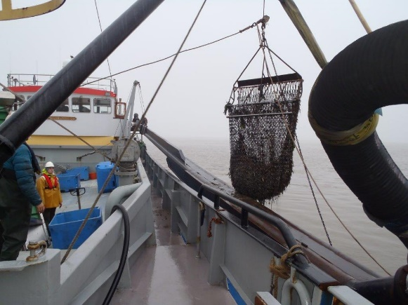
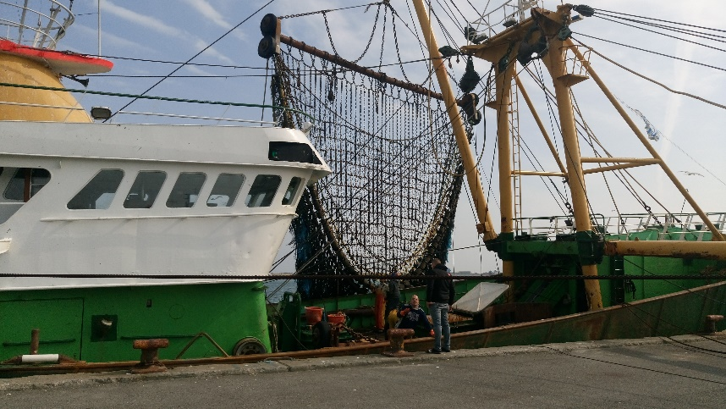
Special requirements for fishing vessels
catching mollusc
Special requirements for fishing vessels
using beam trawls

Slide 8
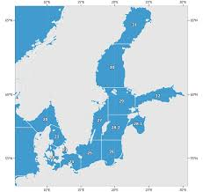
Regulation of Fish Quotas
National regulation of TAC’s

Slide 10
Regulation
From Olympic fisheries to individual fisheries:
TAC divided into quarters (3 month period), and then again divided into specific regulation:
Monthly/weekly/daily quota
Quota depending on the length of the vessel
Quota depending on the status of the vessel:
Another fishing vessel
Fishing vessel with low income
Fishing vessel with medium or high income
Fishing vessel owned by a part-time fisherman

Slide 11
New regulation
In 2007 we introduced a new regulation. The fishing fleet is divided into 4 categories:
ØF – Another vessel, that do not have quotas.
MAF – Less active fishing vessel. Olympic quotas
FKA – Fishing vessel with shares of the Danish quota, but linked to the vessel
IOK – Fishing vessel with shares of the Danish quota. Quota is not linked to the vessel

Slide 12
New regulation
Regulation needs day-to-day management.
Regulation on day-to-day basis is done through:
updated conditions in fishing licences
“annex 6” announcements

