Slide 1

SURFACE WATER QUALITY
MANAGEMENT IN TURKEY
ISTANBUL INTERNATIONAL
SOLID WASTE, WATER AND WASTEWATER (3W)
2013 CONGRESS
Istanbul Golden Horn Congress Center
22-24 May 2013
Ahmet Rıfat İLHAN
Expert

Slide 2

CONTENT OF THE PRESENTATION
Surface Waters
Main Principles of the Environmental (Water) Management
Responsibilities and Roles in Water Management
Turkey’s National Water Management Plans
NagotiationProcess for the Chapter on Environment
By The Accession to EU (What Will Change?)
Bottlenecks/Challenges
Solutions To Bottlenecks/Challenges
Status of Surface Waters
Results To Be Achieved

Slide 3

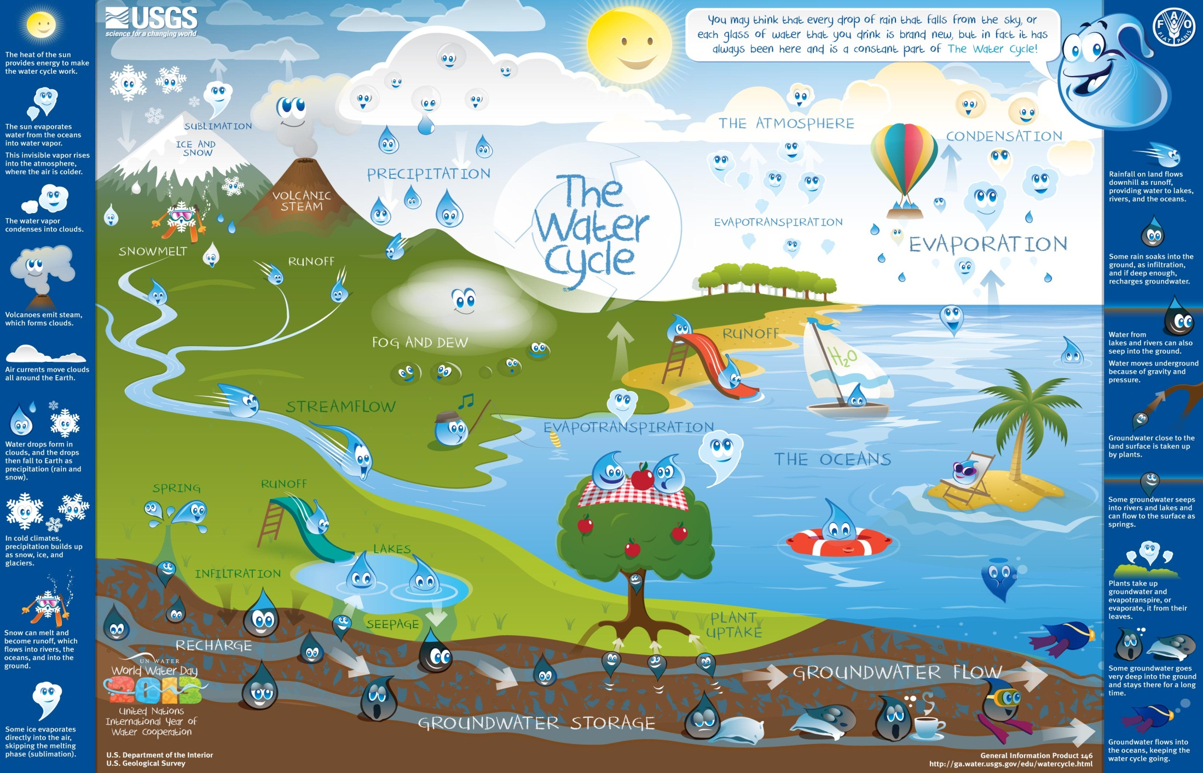
Surface Waters

Slide 4
Main Principles of the
Environmental (Water) Management
Reuse
Recycle
Reject
5R Principle
React
Reduce

Slide 5
Responsibilities and Roles in
Water Management
Coordination, Policy and Legislation
PLANNING
Water Use
Licenses, incentives
EVALUATION
Agriculture, Drinking Water, Hydropower, Industry etc.
Control, Protection
Operational water management, permits, monitoring, execution, inspection
Quality, Quantity
Investments on Water
Operation&Maintenance,
Construction
Dams, dikes, weirs, pumping stations, water beds etc.
Integration with other policies
Notes:
Management and planning in our country is integrated as is shown in the scheme.
The competent authority in water management in Turkey is the Ministry of Forestry and Water Affairs. Within the scope of this responsibility, the Directorate General for Water Management has been established. Among the duties of the Directorate General for Water Management, we can list coordination, planning and policy making.

Slide 6


Turkey’s National Water
Management Plans
The objective of the FYDP is to ensure the optimum distribution of all kinds of resources amoung various sectors of the economy.
Major goal of the 9th FYDP (2007-2013) is the environmental protecion and public infrastructure development.

Slide 7


Turkey’s National Water
Management Plans
9thFYDP underlines the fact that rapid urbanization and industrialization process is a pressure on the sustainable use of water resources; that although progress has been made, uncertainty with regard to institutional plurality and fragmentation across sectors remains. This issue is a big challenge on the way to substantial reforms with regard to water resources management.
Therefore better cooperation and coordination is needed between institutions. Water management is gradually improving towards a sustainable development policy by internalizing the concepts of water demand management in the municipal, industrial and agricultural sectors.

Slide 8
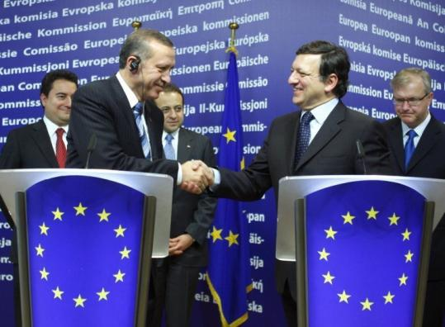
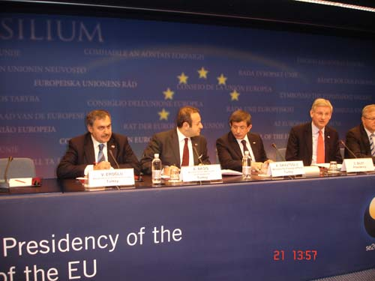
Negotiation Process For The
Chapter On Environment
During the presidency of Sweden, the negotiations for the Chapter on Environment was officially opened at the “Intergovernmental Accession Conference” which took place in Brussel, December 21st, 2009.
Notes:
I would like to express that the chapter on environment was a rather difficult chapter; however, Turkey was very enthusiastic to start the negotiations on this chapter. The most important issue for us at the moment is to be able to close this chapter to negotiations. We know that the investments on infrastructure are of utmost importance especially in the water sector.

Slide 9

By the Accession to EU
What will
?
Notes:
I would like to express that the chapter on environment was a rather difficult chapter; however, Turkey was very enthusiastic to start the negotiations on this chapter. The most important issue for us at the moment is to be able to close this chapter to negotiations. We know that the investments on infrastructure are of utmost importance especially in the water sector.

Slide 10
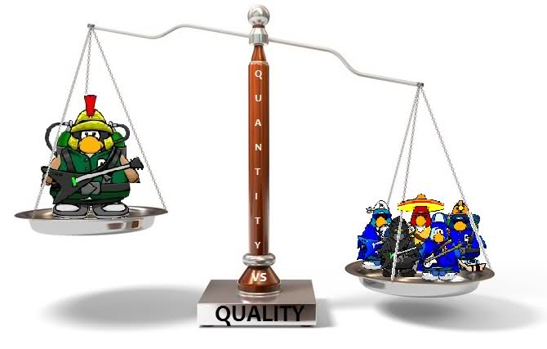

What Will Change?

Slide 11
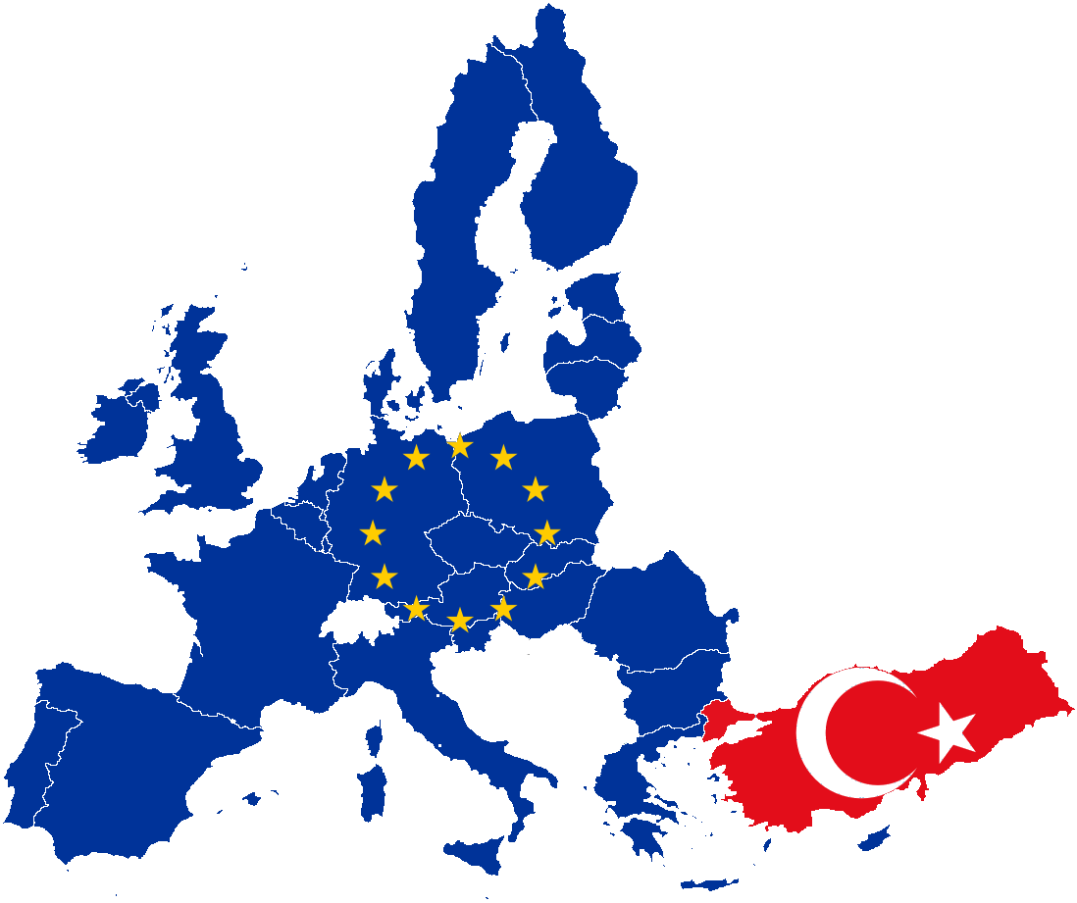
What Will Change?
Transposition
Implementation

Slide 12


What Will Change?
WFD covers;
Financial Costs
Environmental Costs
Resource Costs
Covered in Turkey
Not covered in Turkey

Slide 13
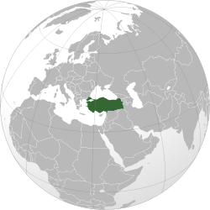
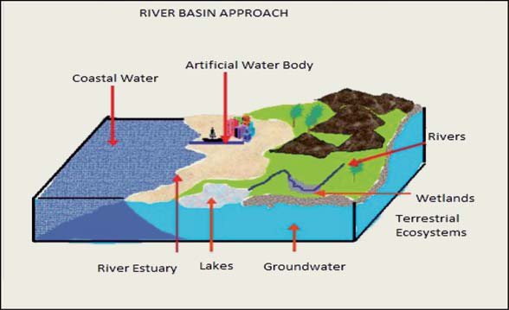
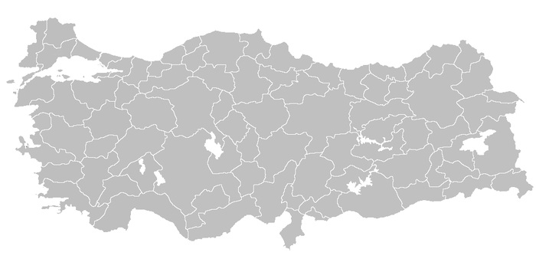
What Will Change?
Water Management according to Administrative Borders

Slide 14

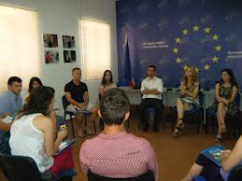
What Will Change?
Non-Participatory Decision Making
Participatory Decision Making

Slide 15
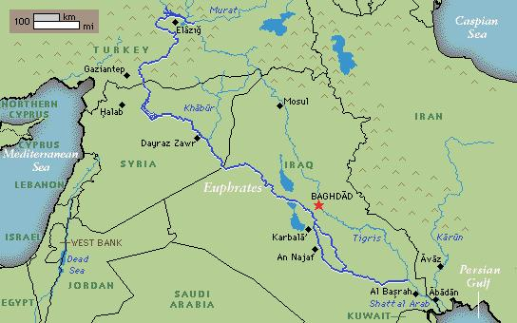
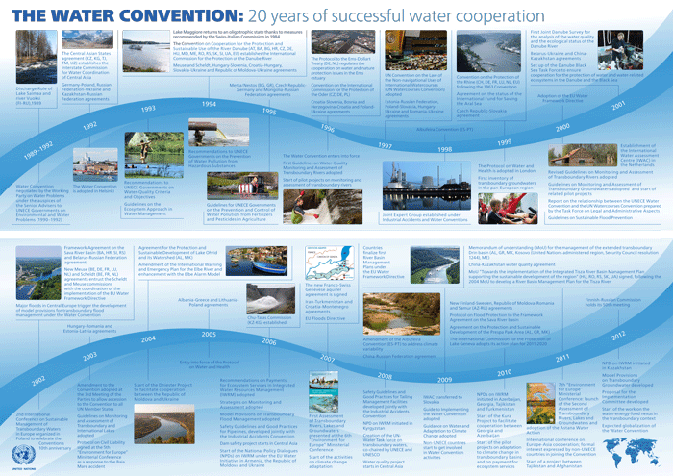

What Will Change?
From limited scope in transboundary water amangement to becoming signatory some international conventions and basin wide agreements wih enhanced scope

Slide 16
Bottlenecks / Challenges
  Authority for water management are numerous institutions, the conflict of competence
  Lack of coordination
  Duplication in Monitoring studies, lack of standardization
  Lack of monitoring network
  Lack of qualified personnel and equipment working in the field monitoring

Slide 17
Solution of Bottlenecks / Challenges
Harmonization of WFD
Revising the existing legislation Environmental Law/By-Law on Water Pollution Control | New legislation*
        Water Law*
        By-law on River Basin protection (Draft)*

Slide 18
Status of Surface Waters

Slide 19
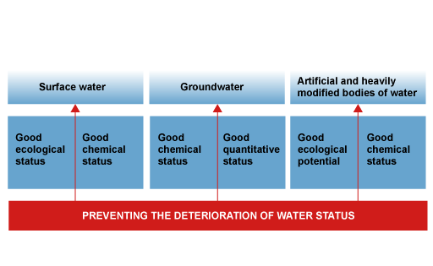
Results To Be Achieved

Slide 20
Thank You!

