Slide 1
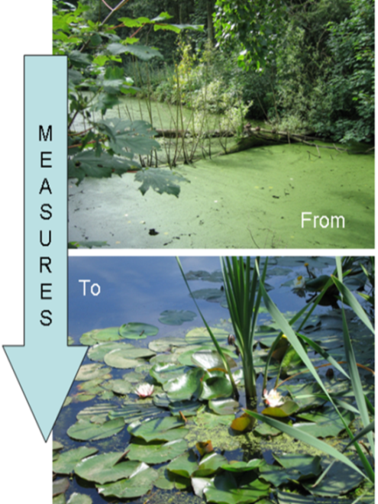
SYMP: Su Yönetimi Modelleme Platformu RBE River Basin Explorer: A modeling tool for river basin planning in Turkey
Hydrology and application of the RIBASIM model

Slide 2
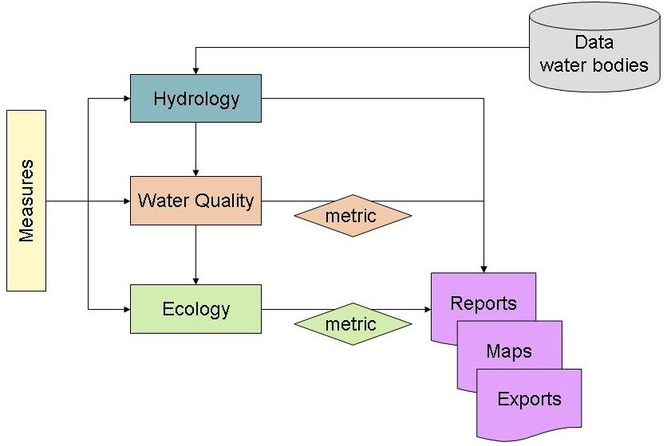
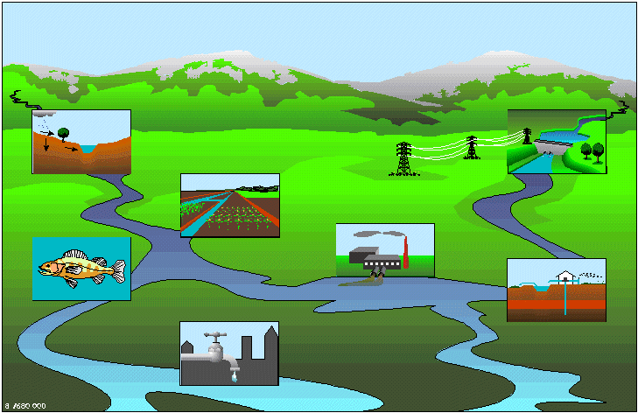
RIBASIM
River Basin Explorer
Export
Import
WFD explorer
Cases
Water balance
Concentrations, EQR, Scores

Slide 3
Workflow of modelling activities
Hydrology
0D-RIBASIM
_{Water Quality}
DELWAQ – Steady state
Ecology
Knowledge rules
GIS maps
Networks
Meteo
Flow
Loads
Substances
Processes
Species
EQR
EKF

Slide 4
Objectives of use of RIBASIM
To analyze water availability and water demand
To quantify impact of water allocation under scarcity on different water using activities (irrigation, hydropower, public water supply, environmental flows)
To optimize operation of existing infrastructure (dams, pumps)
To quantify impact of socio-economic and climate scenarios
To quantify impact of investment in new infrastructure
To prepare a consistent water balance for analysis of water quality

Slide 5
Objective of use of RIBASIM in this project
To prepare the hydrological input for the WFD Explorer :
Flow through all the WFD water bodies
In a dry, a wet and a normal year
On a quarterly basis
Used in WFD Explorer:
To calculate transport of pollutants
To assess difference between natural and artificial flow regime

Slide 6
Differences from most model applications
Time scale (results quarterly instead of hourly to monthly)
Accuracy (flow pattern is important not the actual discharge or water level)
Looking backward in time (the analysis is historical and can be based entirely on flow observations)
Initially limited time input. The hydrological modelling may later be extended for other purposes.

Slide 7
RIBASIM
Generic modeling software for water resources management
Used world-wide by Deltares and numerous governmental agencies, research institutes and consultancy companies
Currently licensed software, being converted to freeware and finally open source (as all Deltares software)
Application of RIBASIM combines:
RIBASIM software
Network schematization of river basin
Data on objects in schematization
Time series on hydro-meteorological parameters
Flow data from hydrologic model or monitoring data

Slide 8
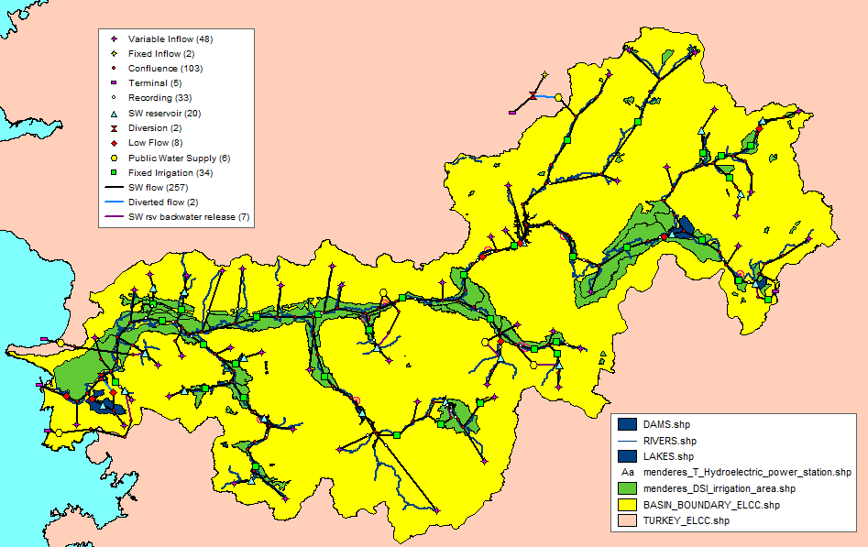
Schematization Buyuk Menderes

Slide 9
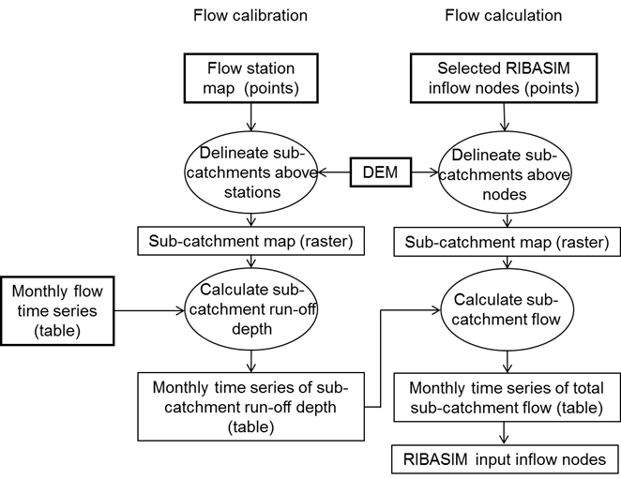
Approach to derive flows from monitoring data

Slide 10
Data requirements and availability
Data item | Availability | In RIBASIM
Digital Elevation Model | SRTM from internet | Used to derive sub-catchments
Discharges | 52 stations, nearly 50% missing values and 10% zeros, appeared poor in quality Inflow and outflow of some reservoirs, better quality | Variable inflow calculated from runoff depths observations. Data gaps filled by assigning other stations. By replacing monitoring stations with reservoir data quality improved.
Reservoir levels | Not available | Could improve calibration
Water abstractions | Incomplete | Irrigated area partly derived from flow measurements in river
Reservoir operation rules | Not available | Derived from bathymetry and downstream irrigation area and flow observations
Evaporation | Available for some reservoirs | All reservoirs same evaporation data from Adiguzul

Slide 11
RIBASIM model
Period from October 2003 till September 2011
Time step one month
Cindere reservoir removed from schematization, because residence time smaller than one month
Calculation for actual situation and natural flow regime (without dams and water use)
Assumed each reservoir only supplies the nearest downstream irrigation area (no coordination)
Results presented as graphs of monthly and quarterly flows

Slide 12
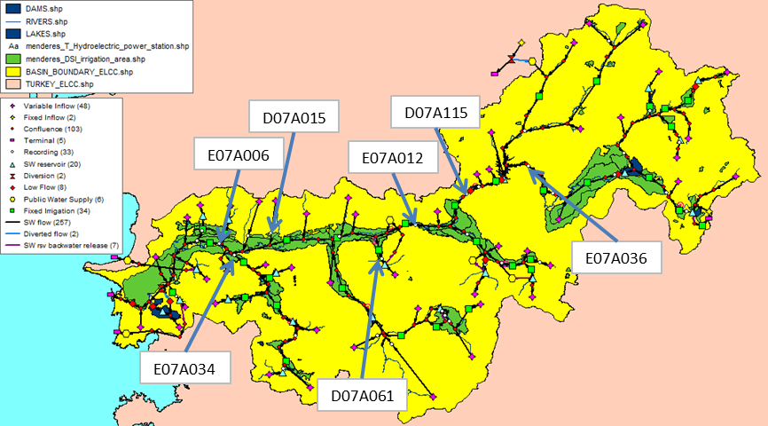
Results RIBASIM – station E07A006

Slide 13
Results RIBASIM – station E07A006
Most downstream monitoring station with data for a number of years
Much better calibration results than in mission 3, especially for dry years
Low flows 2004 and 2005 underestimated
Peak in 2006 overestimated
Most likely from limited information on operation rules
Natural flow much higher, especially during peak flow

Slide 14
Results RIBASIM – station E07A034

Slide 15
Results RIBASIM – station E07A034
Very good calibration results
More limited difference between artificial and natural flow regime

Slide 16
Results RIBASIM – station D07A015

Slide 17
Results RIBASIM – station D07A015
Calibration result not so good
Lots of zero flow in monitored flow
Use of monitored time series leads to unrealistic results downstream
Monitored time series replaced by runoff depth calculated for Adiguzul Reservoir

Slide 18
Results RIBASIM – station D07A061

Slide 19
Results RIBASIM – station D07A061
Calibration result not so good
Missing information operation rules Karacasu Reservoir

Slide 20
Results RIBASIM – station E07A036

Slide 21
Results RIBASIM – station E07A036
Average annual flow simulated correctly
Much more seasonal dynamics in simulation than in measurement
Missing information on operation rules for outflow Isikli Lake

Slide 22
Results RIBASIM – station D07A115

Slide 23
Results RIBASIM – station D07A115
Flow in Buyuk Menderes just downstream of Cindere Reservoir completely dictated by irrigation water demand
Natural flow reduced in some years and increased on others by dam operation
Timing of peak flow changed from winter to summer
Very low flow in winter

Slide 24
Results RIBASIM – station E07A012

Slide 25
Results RIBASIM – station E07A012
Flow in Buyuk Menderes downstream of Cindere Reservoir dictated by irrigation water demand
Natural flow reduced and timing of peak flow changed from winter to summer

Slide 26
Conclusions
RIBASIM model results are adequate for use in WFD Explorer
Results for upstream tributaries can differ significantly from reality due to use of data from other catchments
Coverage and quality of flow monitoring can be improved. Quality of inflow records for reservoirs is good
Assumption that reservoirs are operated to supply only the nearest downstream irrigation area seems valid. There is potential to optimise reservoir operation & storage in the basin by coordinating reservoir releases

Slide 27
Possible improvements RIBASIM model
Reduce time step to half a month and include Cindere Reservoir
Add data on all irrigation areas, at least the irrigated area
Add data on hydropower generation and demand;
Collect data on monthly inflow, outflow and levels of all reservoirs for better calibration
Collect operation rules for all reservoirs to know in what circumstances water will be released and adapt from these the reservoir input in RIBASIM.

Slide 28
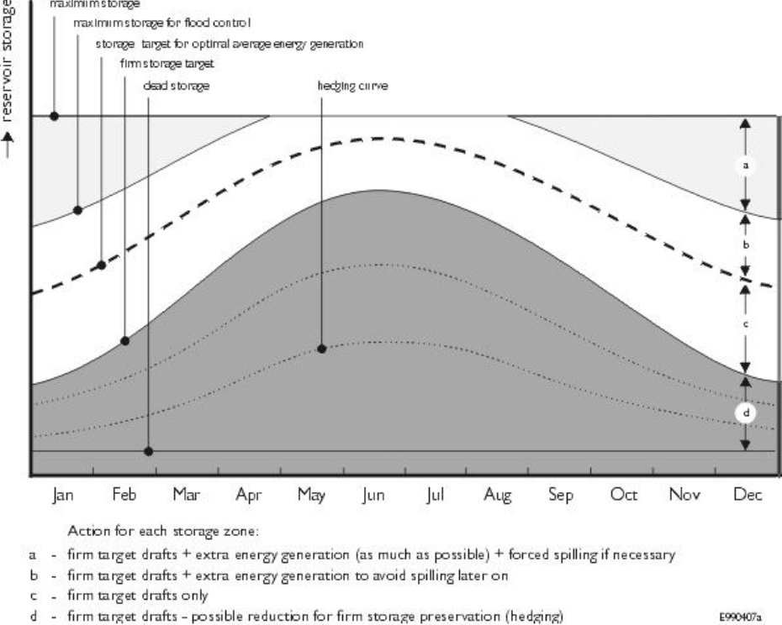
Reservoir operation rules in RIBASIM

Slide 29
Recommendations
Improve discharge monitoring by more continuous monitoring at the same location and better data validation
Reduce effort required for data collection by sharing data in a central system, such as the Turkish National Water Information System under development
Apply RIBASIM to improve water allocation by coordinated operation of reservoirs
Improve understanding of the hydrology of the Buyuk Menderes by applying a distributed hydrologic model, such as Wflow
Use WFlow results to improve the RIBASIM model
Apply RIBASIM to analyze and improve water resources management in Buyuk Menderes basin balancing the demands of irrigation, hydropower, public and industrial water supply, water quality and ecology
Apply Wflow-RIBASIM to assess the impact of climate change and socio-economic scenarios

