Slide 1
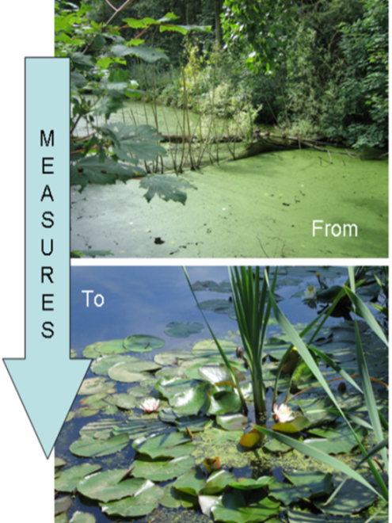
SYMP: Su Yönetimi Modelleme Platformu
RBE River Basin Explorer:
A modeling tool for river basin planning in Turkey
Road map hydrology and water allocation

Slide 2
Road map hydrology and water allocation
Some ideas to start the discussion
Import to link with on-going projects
First some general recommendations
Then 5 projects:
  Inventory of existing models in Turkey and modeling capacity
  Improved water allocation and reservoir operation Buyuk Menderes
  Scenario analysis future water scarcity and ecology Buyuk Menderes
  Scenario analysis future water scarcity and ecology in a basin with mixed surface and groundwater use – Konya Basin
  Improved water allocation and scenario analysis other basins of Turkey

Slide 3
General recommendations (1)
Present RIBASIM results Buyuk Menderes at next monthly meeting ‘model expertise board’
Improve discharge monitoring
  more continuous monitoring at the same location
  better data validation
  Use RIBASIM to support design of monitoring network
Reduce effort required for data collection by sharing data in a central system, such as the Turkish National Water Information System under development

Slide 4
General recommendations (2)
Capacity building
  Construction of river basin models
  Application of river basin models to improve water allocation and prepare management strategies
  Formal training
  On-the-job training in projects
Involve universities, scientific institutes, other governmental agencies and all stakeholders in construction and application of models – collaborative modeling

Slide 5
  Inventory of existing models in Turkey and modeling capacity
Goal:
To know for which basins models exist and where capacity exists for constructing and applying models
Actions:
Collect data on previous and on-going modeling studies
Interviews with key-persons
  When: This year
  Partners: DSI Planning dept , DSI regional directorates, universities, scientific institutes, consultants, NGOs

Slide 6
Improved water allocation and reservoir operation Buyuk Menderes
Goal:
Improve water allocation, balance between water users and reservoir operation resulting in more efficient water resources management for irrigation, hydropower, public water supply, water quality and ecology
Actions:
Improve current RIBASIM model application Buyuk Menderes with data on irrigation, environmental flows, hydropower and operation rules
Cooperate with on-going DSI project Master Plan Buyuk Menderes
Master Plan could use RIBASIM to analyse their data
Detailed data from Master Plan could be included in RIBASIM
  When: Now till 2016
  Partners: DSI Planning dept , DSI regional directorate and consultant Akarsu

Slide 7
  Scenario analysis future water scarcity and ecology Buyuk Menderes
Goal:
Improve future water resources management by analyzing impact of climate change and socio-economic developments and possible management strategies
Actions:
Improve current RIBASIM model application Buyuk Menderes with data on irrigation, environmental flows, hydropower and operation rules
Apply distributed hydrologic model WFlow to Buyuk Menderes
Use WFlow (and other models) results in RIBASIM
On-going climate change project can use WFlow-RIBASIM to analyze climate change impact on water resources or could provide projections for P, E and T
Design and evaluate management strategies for climate change in 2050 and 2100
When: Now till 2016
  Partners: Climate change project

Slide 8
Scenario analysis in a basin with mixed surface and groundwater use – Konya Basin
Goal:
Improve future water resources management by analyzing impact of climate change and socio-economic developments and possible management strategies
Actions:
Apply distributed hydrologic model Wflow to Konya
Apply groundwater model Modflow to Konya
Use WFlow-Modflow results in RIBASIM
Cooperate with on-going climate change project
Cooperate with DSI Master Plan Konya
Design and evaluate management strategies for climate change in 2050 and 2100
When: Now till 2017 or 2018
  Partners: Climate change project, DSI Planning dept. and regional directorate, universities/scientific institutes?

Slide 9
Improved water allocation and scenario analysis other basins of Turkey
Goal:
Improve water allocation, reservoir operation and future water resources management by analyzing impact of climate change and socio-economic developments and possible management strategies
Actions:
Apply distributed hydrologic model Wflow and/or other models
Apply groundwater model Modflow where groundwater is important
Use Wflow(-Modflow, other models) results in RIBASIM
Cooperate with on-going climate change project
Cooperate with DSI Master Plans
Design and evaluate management strategies for climate change in 2050 and 2100
When: Now till 2018
  Partners: Climate change project, DSI Planning dept. and regional directorates, universities/scientific institutes?

Slide 10
Time line

Slide 11
Sources of financing
Decreasing external sources
Tubitak
DSI
DG Water Management
???

