Slide 1
Drought, Water Management in Drought Period and Vulnerability
MINISTRY OF FORESTRY AND WATER AFFAIRS
GENERAL DIRECTORATE OF WATER MANAGEMENT
HÜSEYİN AKBAŞ
DEPUTY GENERAL DIRECTOR

Slide 2
DEFINITION OF DROUGHT
Drought, means the naturally occurring phenomenon that exists when;
Precipitation has been significantly below long term average of recorded levels which;
Adversely affects water, soil and living creatures,
Causes serious hydrological imbalances,
Droughts can be characterized by severity, duration, and geographical distribution components.
1/16

Slide 3
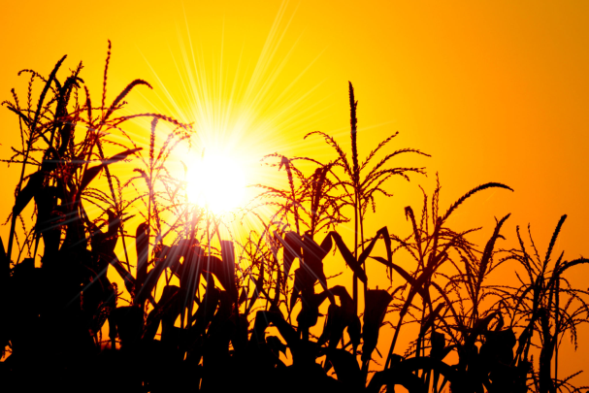
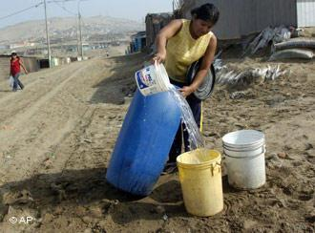
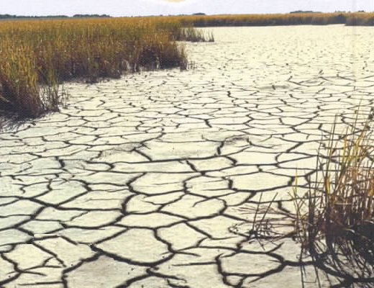
DROUGHT AND SIMILAR CONCEPTS
Drought is a temporary phenomena and occurs as a result of deviations in natural (climatic) processes.
Water scarcity is a permanent case, but it occurs as a result of human activities and water demands of people.
Desertification is a type of land degradation in semi-arid and low-precipitation areas which stems from various factors including climate change and human activities.
2/16

Slide 4
RELATIONS BETWEEN METEOROLOGICAL, AGRICULTURAL, HYDROLOGICAL AND SOCIO-ECONOMIC DROUGHTS
Natural Climate Variability
Precipitation Deficiency
(Amount, Intensity, Timing)
High Temperature, Strong Winds, Low Relative Humidity, High Solar Radiation,
Less Cloud Cover
Meteorological
Drought
Reduced Infiltration, Runoff,
Deep Percolation,
And Ground Water Recharge
Increase in Evaporation and Transpiration
Soil Water Deficiency
Time (duration)
Agricultural Drought
Plant Water Stress, Reduced Biomass and Yield
Socio-Economic Drought
Reduced Streamflow, Inflow to Reservoirs, Lakes, and Ponds; Reduced Wetlands, Wildlife Habitat
Hydrological Drought
Economic Impacts
Social Impacts
Environmental Impacts
3/16
Source: National Drought Mitigation Center, University of Nebraska – Lincoln, USA

Slide 5
DROUGHT IN TURKEY
Majority of Turkey is located in the Mediterranean Climate Zone where significant differences in seasonal rainfall can be observed.
Since one of the characteristics of the Mediterranean Climate Zone is the periodic variations of rainfall amounts, drought episodes are inevitable.
As a result, drought is one of the climate-related problems that Turkey experiences and likely to encounter frequently.
4/16

Slide 6
Arid and Humid Climatic Areas of Earth and Desertification Trends (Türkeş, 2010)
5/16

Slide 7
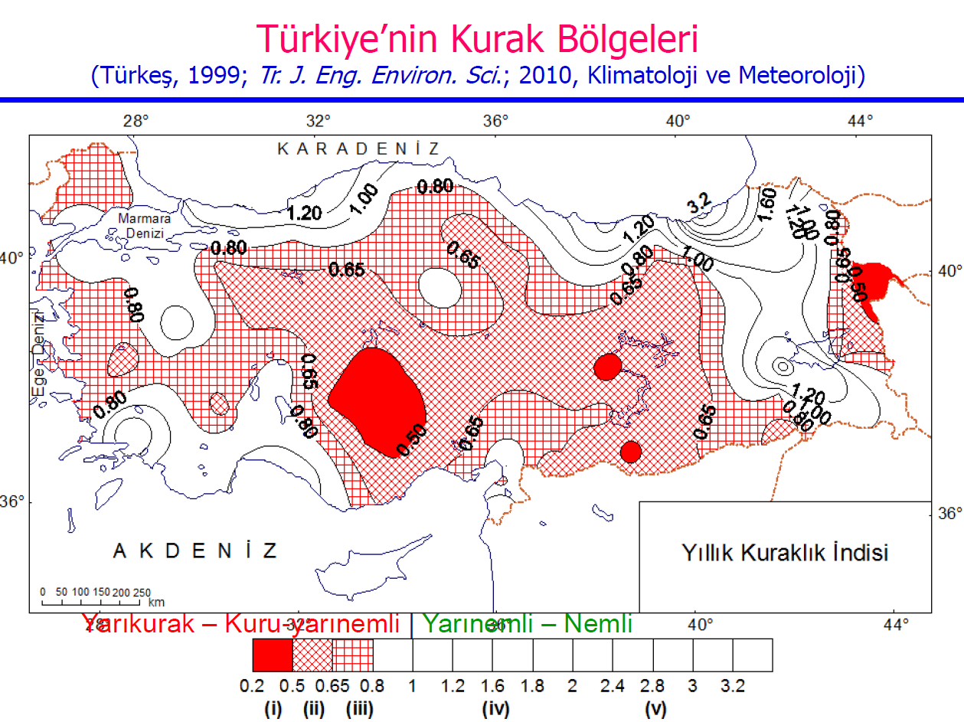
DRY LANDS OF TURKEY
6/16

Slide 8
DROUGHT MANAGEMENT
Drought Management:
In order to solve the drought problem by mitigating the negative impacts of possible droughts, drought management can be defined as the combination of:
Determination of the measures to be taken
Before,
During and
After drought periods,
Preparation of action plans and
Monitoring the application of these plans.
7/16

Slide 9
DROUGHT MANAGEMENT
Effects of Drought on Sectors:
Drought affects many sectors directly (particularly municipal waters and agriculture).
(Lillian Florin Valdo, UNFCCC, 2006)
8/16

Slide 10
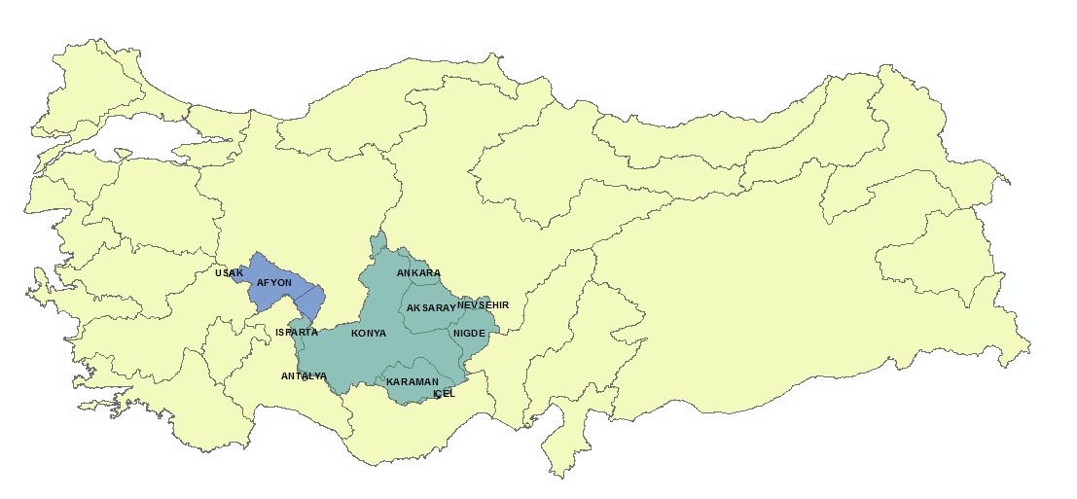
PREPARATION OF DROUGHT MANAGEMENT PLANS
Akarçay Basin Drought Management Plan
Konya Basin Drought Management Plan
9/16

Slide 11
CHECKLIST OF WORKS TO BE CONDUCTED WITHIN THE SCOPE OF KONYA BASIN DROUGHT MANAGEMENT PLAN
PRELIMINARY REPORT
Collecting data regarding the topography, geography, jeology and water resources of the basin
1st INTERIM REPORT
Determination of drought indices, indicators and threshold values.
Determination of the water potential and change in the water potential of the basin.
2nd INTERIM REPORT
Preparation of drought maps.
Determination of the measures to be taken in order to reduce the effects of drought and water scarcity.
Conducting sectoral impact analysis.
FINAL REPORT
Establishing the Drought Database of the basin.
Collecting data regarding the land usage, agriculture, meteorology and hydrology.
10/16

Slide 12
THE EFFECTS OF CLIMATE CHANGE ON WATER RESOURCES PROJECT
Scope of the Project:
1
For all of the basins, preparation of climate change projections
2
For all of the basins, determination of the changes in surface and ground water levels
For all of the basins, modelling of water potential
4
For three basins, conducting sectoral impact analysis (for municipal water, agriculture, industry and ecosystem) in terms of the effects of climate change on water resources
3
11/16

Slide 13
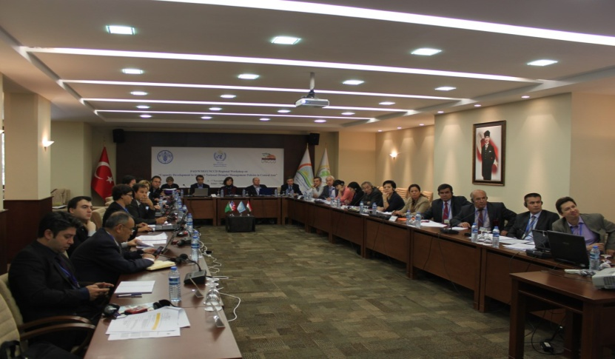
THE EFFECTS OF DROUGHT ON SECTORS AND EXAMPLE SOLUTIONS
The Food and Agriculture Organization of the United Nations (FAO), the World Meteorological Organization (WMO) and the United Nations Convention to Combat Desertification (UNCCD) co-organized a Regional Workshop ‘Capacity Development to Support National Drought Management Policies in Central Asia’ from 04 to 07 November 2013, in Izmir, Turkey.
The outputs of the Turkish working group on the effects of drought on sectors and the proposed solutions were as follows,
12/16

Slide 14
THE EFFECTS OF DROUGHT ON SECTORS AND EXAMPLE SOLUTIONS (1)
Effect of Drought | Results of the Effect | Actions |  |  | Agencies
 |  | Short Term | Medium Term | Long Term
Changes in river/basin regimes | Decrease in the water level of irrigation dams below normal levels | Restrictions on the production of the second or third crops. Restriction of fertilization. | Crop patterns are determined in accordance with the water levels in the reservoirs. | Building irrigation dams and monitoring the water levels of these dams. Supporting the pressurized irrigation systems. | MFWA, MOFAL, DSI
 | Decrease in the levels of surface and groundwater's | Terracing in watersheds to decrease overflow | Integrated participatory watershed management works. | Afforestration works | MFWA, DSI
13/16

Slide 15
THE EFFECTS OF DROUGHT ON SECTORS AND EXAMPLE SOLUTIONS (2)
Effect of Drought | Results of the Effect | Actions |  |  | Agencies
 |  | Short Term | Medium Term | Long Term
Increasing scarcity of water for use | Decrease in the water level of municipal water supplies | Water transfers between river basins | Building infrastructure to supply water in extreme conditions | Increasing public awareness to save water | MFWA, DSI and Municipalities
Forest fires | Number of trees lost by fire | Early warning system to extinguish fires as quickly as possible with fire fighter planes | Plantation of drought and fire tolerant trees. Establishing fireproof forest. | Early warning and monitoring systems, Education and raising awareness on forest fires | MFWA
14/16

Slide 16
THE EFFECTS OF DROUGHT ON SECTORS AND EXAMPLE SOLUTIONS (3)
Effect of Drought | Results of the Effect | Actions |  |  | Agencies
 |  | Short Term | Medium Term | Long Term
Reduced livestock productivity | Loss of productivity per head - crop lost | Destocking livestock | Interregional straw transfers, importing livestock | Malnutrition, Reducing the consumption of meat in the country | MOFAL
Reduced hydropower potential | Decrease in the water levels of energy production dams | Increase water price per kw/hour | Increase importing petroleum | Finding alternative energy sources | MENR, DSI
Reduced aqua-production | Decrease in production of the water products | Destocking water products | - | Promoting alternatives for aqua products | MOFAL
15/16

Slide 17
THE EFFECTS OF DROUGHT ON SECTORS AND EXAMPLE SOLUTIONS (4)
Effect of Drought | Results of the Effect | Actions |  |  | Agencies
 |  | Short Term | Medium Term | Long Term
Land degradation-Loss of soil quality. | High level of salinity, low organic matter and carbon levels, destruction of physical structure | Increasing the irrigation efficiency, erosion control | Using good agriculture practices, organic farming | Subsidies on soil analysis works, organic farming, education and raising public awareness | MOFAL / MFWA
16/16

Slide 18
MINISTRY OF FORESTRY AND WATER AFFAIRS
GENERAL DIRECTORATE OF WATER MANAGEMENT
THANK YOU
HÜSEYİN AKBAŞ
DEPUTY GENERAL DIRECTOR

