Slide 1
WATER MANAGEMENT IN TURKEY River Basin Protection Action Plans & River Basin Management Plans
Osman ÖZDEMİR
Deputy Expert
İstanbul, 20.05.2015

Slide 2
CONTENT
Water resources of Turkey
Legal and Institutional arrangements in water sector
River Basin Protection Action Plans
River Basin Management Plans
Other Studies
The New Water Management Structure in Turkey

Slide 3
WATER RESOURCES OF TURKEY

Slide 4
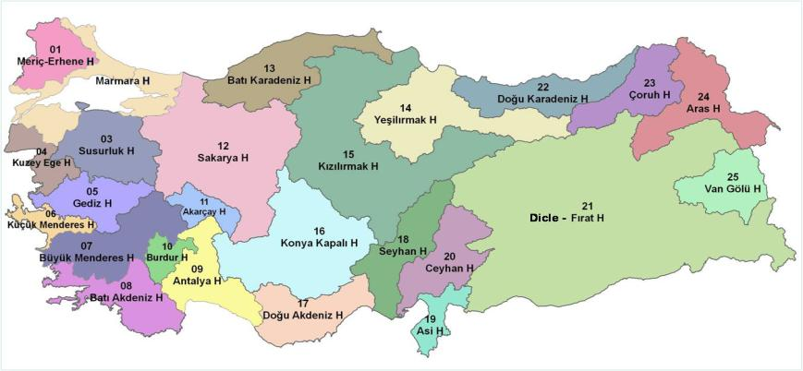
25 River Basins

Slide 5
PRECIPITATION CHARACTERISTICS
2500 mm
250 mm
Precipitation changes according to seasons and regions
Turkey which is in a semi-arid part of the world
The rivers often have irregular flow regimes. We have to adopt the climate by improving forestation and increasing reservoir capacity.

Slide 6
Water Potential and Consumption
Run off from neigbour countries
7 km³
Mean annual precipitation volume
501 km³
Evaporation
274 km³
Annual surface runoff
186 km³
--------------------------------- Exploitable : 95 km³ (49%)
Leakage to aquifers
41 km³
Surface runoff
193 km³
Gross water potential
234 km³
Total exploitable water
112 km³
Annual available surface water
98 km³
Annual safe yield
14 km³
Present consumption
44 km³
(40% of total)

Slide 7
WATER POTENTIAL PER CAPITA
YEAR | POPULATION (MILLION) | WATER POTENTIAL (m³/PERSON.YEAR)
1990 | 57 | 1965
2000 | 68 | 1650
2015 | 77.5 | 1442
2023 | 85 | 1300
TURKEY IS WATER-STRESSED COUNTRY

Slide 8
LEGAL and INSTITUTIONAL ARRANGMENTS in WATER SECTOR

Slide 9
LEGISLATION ON WATER
Growing population = increase in agriculture and industry
The first law in Turkey on water is Law on Water, enacted in 1926, including drinking water issues.
Then,
1930 Municipality Law, numbered as 1580,
1943 Protection Law against Floods, numbered as 4373,
1954 DSİ Law, numbered as 6200,
1960 Groundwater Law, numbered as 167,
1968 Supplying Drinking, Potable and Industrial Water to Settlements having Municipality, numbered as 1053
1983 Environmental Law, numbered as 2872,
1988 By-law on Protection of Water Pollution,

Slide 10
DEVELOPMENTS OF WATER MANAGEMENT
European Union (EU) membership process since 1999
Negotiations on full EU membership since 2004
Environment chapter has been officially opened on 21st of December, 2009.

Slide 11
EU ENVIRONMENT CHAPTER
In order to meet the benchmarks of the “Water Sector” under the Environment Chapter of EU;
Turkey adopts legislation aimed at transposing the EU's horizontal and framework environmental legislation, including its transboundary aspects;
Such as Water Framework Directive, Urban Waste Water Directive and Flood Directive
Turkey adopts legislation aimed at transposing the acquis in the field of water quality, notably its Framework Water Protection Law; establishes River Basin Management Plans; and makes further significant progress in legislative alignment in this sector by adopting and implementing the EU legislation.

Slide 12
REARRANGMENT OF THE INSTITUTIONS
In mid 2011, the ministries have been rearranged in Turkey.
Ministry of Forestry and Water Affairs has been authorized to carry on water sector under the EU Environment Chapter.
GENERAL DIRECTORATE OF WATER MANAGEMENT
General Directorate of Water Management (GDWM) was established on 4 July 2011
Mission: to gather all the organizations and institutions that have water-related tasks and liabilities in an effective way, and to provide a national water policy according to national priorities and global trends.

Slide 13
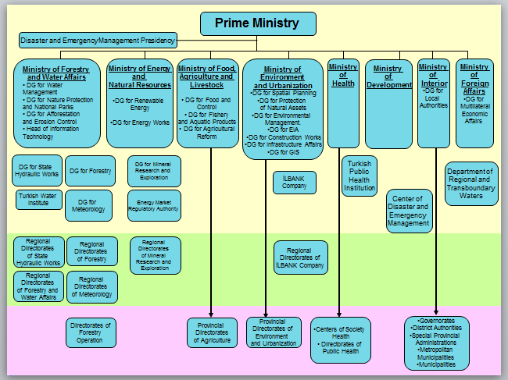

Slide 14
General Directorate of Water Management
In order to achieve its goals and responsibilities, to coordinate all the organizations and institutions, and to adopt and implement the EU legislation relating water sector
GDWM has 7 department:
BASIN MANAGEMENT DEPARTMENT
QUALITY MANAGEMENT DEPARTMENT
FLOOD AND DROUGHT MANAGEMENT DEPARTMENT
MONITORING AND WATER INFORMATION SYSTEM DEPARTMENT
INVENTORY AND RESEARCH DEPARTMENT
WATER LAW AND POLICY DEVELOPMENT DEPARTMENT
MANAGEMENT SERVICES DEPARTMENT

Slide 15
RIVER BASIN PROTECTION ACTION PLANS

Slide 16
RIVER BASIN PROTECTION ACTION PLANS
River Basin Protection Action Plans for 25 basins have been prepared in lots between 2009 – 2013.
CONTENT OF THE RBPAPs
Characterization of existing situation
surface water and groundwater resources
Pollution
identification of pressures and impacts
activities in the river basin
details of pollution sources and loads;
identification of water potential, utilization purposes and environmental infrastructure status

Slide 17
RIVER BASIN PROTECTION ACTION PLANS
River Basin Protection Action Plans for 25 basins have been prepared in lots between 2009 – 2013.
CONTENT OF THE RBPAPs
Describing important pressures within the river basin and listing required measures for reaching good water quality; preventing pollution; calculating environmental flows.
Establishing a work calendar consisting short, medium and long term measures
These calendars divides the responsibilities to all stakeholders according to a time schedule in order to protect and improve river basins.

Slide 18
RIVER BASIN PROTECTION ACTION PLANS
Gediz Basin Water Quality Classification
18

Slide 19
19

Slide 20
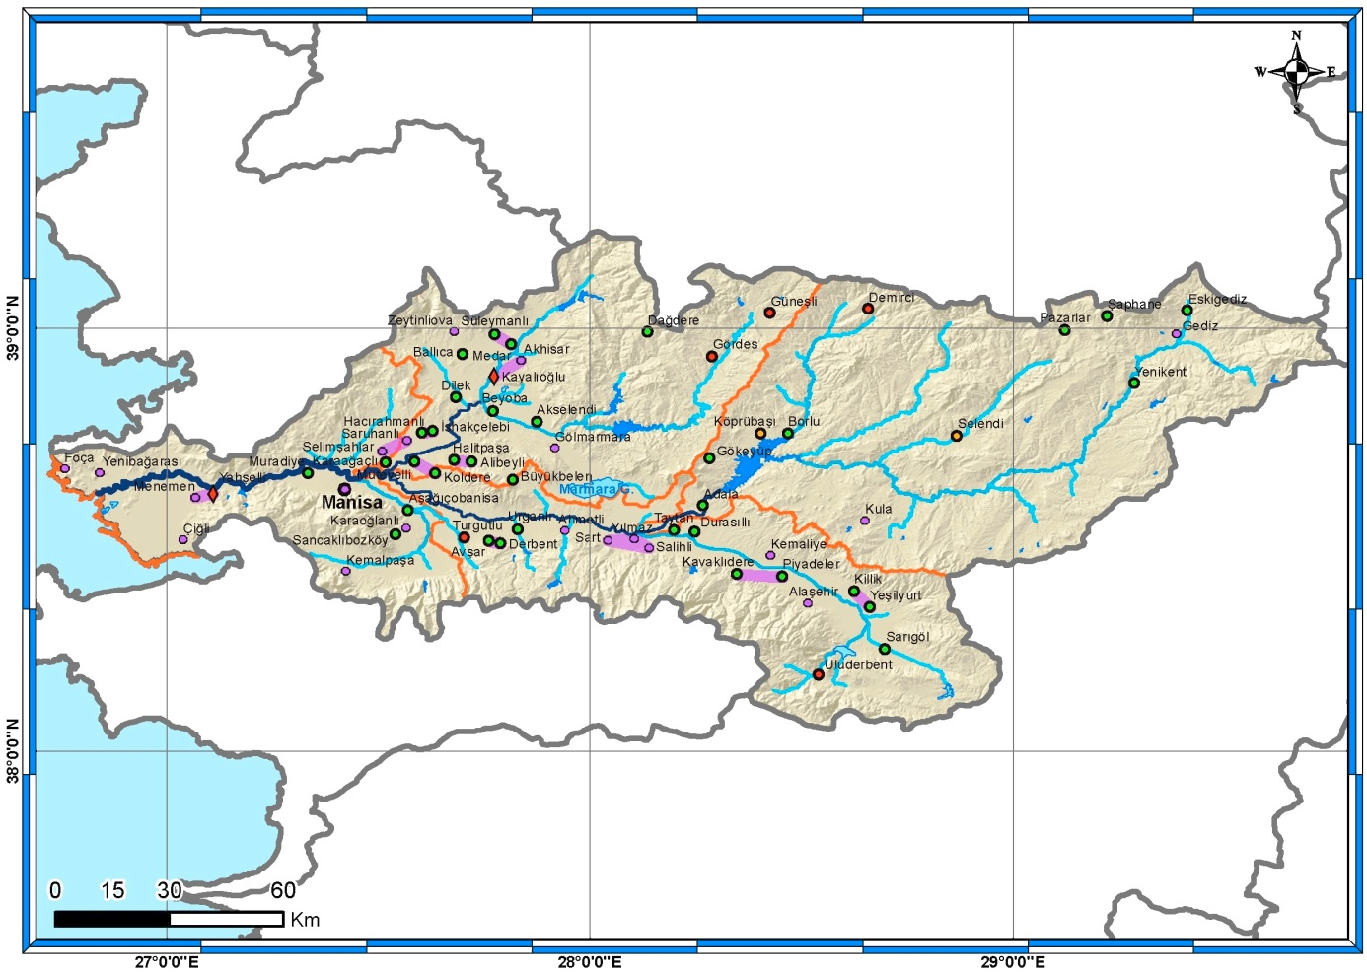
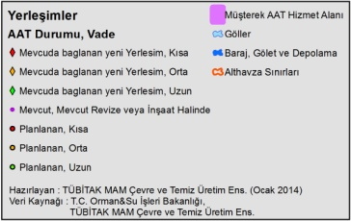
RIVER BASIN PROTECTION ACTION PLANS
Gediz Basin Waste Water Treatment Plants and Prioritization
20

Slide 21
Gediz Basin Waste Water Treatment Plants and Prioritization
21

Slide 22
RIVER BASIN PROTECTION ACTION PLANS
The actions defined in the work calendar which consists of short, medium and long term measures
ACTIONS
Urban Wastewater Treatment Plants
Separate Industries and Industrial Organized Zones Wastewater Treatment Plants
Solid and Hazardous Waste Recycling and Disposal
Dredging and Reclamation of River Bed
Combating Erosion and Forestation
Control of Agricultural (diffuse) Pollution
Monitoring and Inspection of Water Quality
Hot Spots
Special Actions for Basins : Olive black water etc.

Slide 23
RIVER BASIN MANAGEMENT PLANS

Slide 24
WATER FRAMEWORK DIRECTIVE
Aims at the integral protection of the aquatic environment.
This aim is basically linked to the quality of related waters.
The control of quantity is a subsidiary element for the protection of good water quality.
Measures should also be established on quantity, which serves the aim of achieving good water quality.
‘good ecological status’
‘good chemical status’

Slide 25
WATER FRAMEWORK DIRECTIVE
Implementation
Phases of implementation process:
Current status of waters
Environmental objectives
Phase 1
Phase 2
Phase 3
RBMP update
Water issues revision
Interim report on implementation status
Monitoring Programmes
Public Participation
Implementation of Programme of Measures
Gap analysis
River Basin Management Plan!!
Programme of Measures

Slide 26
RIVER BASIN MANAGEMENT PLANS
European Union IPA-2011 Project namely “Conversion of River Basin Protection Action Plans into River Basin Management Plans” for Meriç-Ergene, Susurluk, Konya and Büyük Menderes Basins was started on 29 December 2014

Slide 27
STEPS OF A RIVER BASIN MANAGEMENT PLAN
Long-list of measures, Cost effectiveness analysis,
Final list of measures and a regulatory framework including cost recovery
Identification of the River Basin District
Formation of working group
Timetable and work programme
Defining ‘initial’ and ‘final’ (biological and chemical) objectives for each water body
A draft RBMP
Public consultation , Final RBMP
Environmental Objectives
River Basin
District
River Basin
Characterisation
Significant
Water Management
Issues Report
Programme of
Measures
River Basin
Management Plan
Monitoring
Description of the District
Category, class and type of ground/surface water bodies; Description of pressures and impacts
Economic analysis of water use
Risk analysis
A program for operational, surveillance and investigative monitoring – chemical & biological, ground- and surface water
The main water management issues in the District

Slide 28
Key Implementation Steps

Slide 29
RIVER BASIN MANAGEMENT PLAN
Chapters:
Description of the Characteristics of the River Basin
Summary of Significant Pressures and Impacts
Identification and Mapping of Protected Areas
Map of Monitoring Networks and Monitoring Programmes
List of Environmental Objectives
Summary of Economic Analysis
Summary of the Programme of Measures
Register of More Detailed Programmes
Summary of the Public Consultation and Information Measures and Resulting Changes
List of Competent Authorities
Contact Points for Background Information
Notes:
29
1. characteristics:
a general description of the characteristics of the river basin district (Article 5 and Annex II)
including:
. a map showing the the location and boundaries of surface water and each ground water body and bodies,
. a map showing the different surface water body types within the river basin;
2. pressures and impact
a summary of significant pressures and impact of human activity on the status of surface water and
groundwater, including:
. estimation of point source pollution,
. estimation of diffuse source pollution, including a summary of land use,
. estimation of pressures on the quantitative status of water including abstractions,
. analysis of other impacts of human activity on the status of water;
3. protected areas
identification and mapping of protected areas (Article 6 and Annex IV)
4. monitoring networks
. a map of the monitoring networks (Article 8 and Annex V)
. a presentation in map form of the results of the monitoring programmes showing:
4.1. ecological and chemical status of surface water
4.2. chemical and quantitative of groundwater
4.3. status of protected areas;
5. environmental objectives
a list of the environmental objectives established under Article 4 for surface waters, groundwaters and
protected areas, including in particular identification of instances where use has been made of Article 4(4),
(5), (6) and (7), and the associated information required under that Article;
6. economic analysis
a summary of the economic analysis of water use as required by Article 5 and Annex III;
7. programmes of measures
a summary of the programme or programmes of measures adopted under Article 11, including the ways in
which the objectives established under Article 4 are thereby to be achieved;
7.1. a summary of the measures required to implement Community legislation for the protection of water;
7.2. a report on the practical steps and measures taken to apply the principle of recovery of the costs of water
use in accordance with Article 9;
7.3. a summary of the measures taken to meet the requirements of Article 7;
7.4. a summary of the controls on abstraction and impoundment of water, including reference to the registers
and identifications of the cases where exemptions have been made under Article 11(3)(e);
7.5. a summary of the controls adopted for point source discharges and other activities with an impact on the
status of water in accordance with the provisions of Article 11(3)(g) and 11(3)(i);
7.6. an identification of the cases where direct discharges to groundwater have been authorised in accordance
with the provisions of Article 11(3)(j);
7.7. a summary of the measures taken in accordance with Article 16 on priority substances;
7.8. a summary of the measures taken to prevent or reduce the impact of accidental pollution incidents;
7.9. a summary of the measures taken under Article 11(5) for bodies of water which are unlikely to achieve the
objectives set out under Article 4;
7.10. details of the supplementary measures identified as necessary in order to meet the environmental objectives
established;
7.11. details of the measures taken to avoid increase in pollution of marine waters in accordance with Article 11(6);
8. detailed programmes and management plans
a register of any more detailed programmes and management plans for the river basin district dealing with
particular sub-basins, sectors, issues or water types, together with a summary of their contents;
9. public information and consultation measures
a summary of the public information and consultation measures taken, their results and the changes to the
plan made as a consequence;
10. a list of competent authorities in accordance with Annex I;
11. contact points background documentation and information
the contact points and procedures for obtaining the background documentation and information referred to
in Article 14(1), and in particular details of the control measures adopted in accordance with Article 11(3)(g) and 11(3)(i) and of the actual monitoring data gathered in accordance with Article 8 and Annex V.

Slide 30
OTHER ACTIVITIES

Slide 31
LEGISLATION STUDIES
Water Law (Draft)
By-law on Protection of Water Basins and Preparation of Management Plans
The Communiqué on Basin Management Committees Establishment, Duties and Working Principles
By-Law on Drinking Water Supply and Water Losses in Distribution Systems Control Regulation
By-Law on Monitoring Surface and Ground Waters
By-Law on Surface Water’s Quality Procuring or Planned for Procuring as Drinking Water
By-Law on Protecting Ground Waters Against Pollution and Deterioration
By-Law on Management of Surface Water Quality
National Basin Management Strategy

Slide 32
NATIONAL BASIN MANAGEMENT STRATEGY
National Basin Management Strategy (2014-2023) was accepted with the decision of Higher Planning Council in 2014 and put into force.
The target of this strategy is to maintain the sustainable management of basins by achieving coordination and cooperation of institutions and stakeholders
Work Calendar of RBPAPs were attached

Slide 33
NEW WATER MANAGEMENT ORGANIZATIONAL STRUCTURE

Slide 34
ALIGNMENT TO EU WATER ACQUIS
Following re-arrangement of institutions, Ministry of Forestry and Water Affairs has transposed mostly the EU Water Framework Directive into national legislation.
Additionally, other related Directives have been harmonized to Turkish legislation.
In order to make new legislation functional, new water management structure has been introduced to the sector
Main goal of this new water management is more coordinated, cooperated and efficient management at national and basin levels.

Slide 35
NEW WATER MANAGEMENT ORGANIZATIONAL STRUCTURE
WATER MANAGEMENT COORDINATION COMMITTEE
NATIONAL
LEVEL
BASIN STEERING COMMITTEE
REGIONAL LEVEL
BASIN MANAGEMENT COMMITTEE(S)

Slide 36
WATER MANAGEMENT
COORDINATION COMMITEE
“Water Management Coordination Commitee” was established according to the Prime Ministry Circular numbered (2012/7) dated on 20 March, 2012.

Slide 38
WATER MANAGEMENT COORDINATION COMMITEE
Minister of Forestry and Water Affairs
Ministry of European Union Undersecretary
Ministry of Science, Industry and Technology Undersecretary
Ministry of Environment and Urbanization Undersecretary
Ministry of Foreign Affairs Undersecretary
Ministry of Energy and Natural Resources Undersecretary
Ministry of Food, Agriculture and Livestock Undersecretary
Ministry of Internal Affairs Undersecretary
Ministry of Development
Undersecretary
Ministry of Culture and Tourism Undersecretary
Ministry of Health
Undersecretary
General Director
of State Hydraulic Works
General Director
of Water Management
General Director of
Nature Conservation and National Parks
General Director of Combating Desertification and Erosion
General Director of
Meteorology
President of Turkish
Water Institute

Slide 39
WATER MANAGEMENT
COORDINATION COMMITEE
TASKS:
Determination of macro scale measures to conserve the water resources within the framework of integrated river basin management,
Providing inter-sectoral coordination, collaboration and speeding up investment in water provision for an effective water management,
Developing strategy, policy and plan for the realization of the objectives set out in national and international documents,
Evaluation of implementation of the issues that must be met in public institutions and organizations in basin plans,
Ensuring a high level of coordination and cooperation.

Slide 40
BASIN STEERING COMMITTEE
“Basin Steering Commitee” was established according to the “Communique on Basin Management Committees Establishment, Duties and Working Principles” dated on 18/06/2013 dated and numbered as 28681 of Official Gazette.

Slide 41
BASIN STEERING COMMITEE
TASKS :
Following and facilitating of short, medium and long term targets of Basin Protection Action Plans,
Ensuring coordination between institutions during conversion of Basin Protection Action Plans to River Basin Management Plans
Coordinating and following the developments of National Basin Management Strategy
Assessing the developments and coordinating completed or to be prepared Special Provision Determination Studies for drinking water basins.

Slide 42
BASIN STEERING COMMITTEE
Undersecretary of Ministry of Forestry and Water Affairs
Ministry of European Union
General Director
Ministry of Science, Industry and Technology General Director
Ministry of Environment and Urbanization, General Director
Ministry of Foreign Affairs General Director
Ministry of Energy and Natural Resources General Director
Ministry of Food, Agriculture and Livestock General Director
Ministry of Internal Affairs
General Director
Ministry of Development
General Director
Ministry of Culture and Tourism
General Director
Ministry of Health
General Director
General Director
of State Hydraulic Works
General Director
of Water Management
General Director of
Nature Conservation and National Parks
General Director of Combating Desertification and Erosion
General Director of
Meteorology
President of Turkish
Water Institute

Slide 43
BASIN STEERING COMMITEE
Basin Steering Committee will be operational after finalizing of establishment of all Basin Management Committees.
Basin Steering Committee is functional link between Water Management Coordination Committee at center and Basin Management Committees at regions.

Slide 44
BASIN MANAGEMENT COMMITTEE
“Basin Management Commitee” was established according to the “Communique on Basin Management Committees Establishment, Duties and Working Principles” dated on 18/06/2013 dated and numbered as 28681 of Official Gazette.

Slide 45
BASIN MANAGEMENT COMMITTEES
TASKS :
Contribute to preparation of river basin protection action plans and river basin management plans
Tracking and evaluating the implementation of river basin protection action plans and river basin management plans
Contribute to revision of river basin management plans
Provide the public participation

Slide 46
BASIN MANAGEMENT COMMITTEE
CHAIR
(Coordinator Governor)
SEKRETARIAT
(DSI Regional Directorate / Branch Office)
Mayors of Provincial Municipalities
Director General of Water and Wastewater Administration
Secretary General of Special Provincial Administration
Regional Directorates of Ministry of Forestry and Water Affairs
Provincial Directorates of Environment and Urbanization
Provincial Directorates of Food, Agriculture and Livestock
Provincial Directorates of Science, Industry and Technology
Provincial Directorates of Culture and Tourism
Regional Directorates of İlbank Co.
Secretary General of Development Agency
Directorates of Public Health
Irrigation Unions
Representative from GD of Water Management
Representative from Chamber of
Industry and Trade
One representative from each NGOs, Universities and IOZs

Slide 47
BASIN MANAGEMENT COMMITTEE
Basin wide re-organizing will be completed with involving of stakeholders to the decision making process and implementation phase.
EXECUTOR
DECISION MAKER
USER
SPECIALIST

Slide 48
THANK YOU

