Slide 1
MINISTRY OF FORESTRY AND
WATER AFFAIRS
WATER RESOURCES MANAGEMENT
Özge Hande SAHTİYANCI ÖZDEMİR
COP 12
21/10/2015

Slide 2
CONTEXT
INTRODUCTION
EUROPEAN UNION HARMONIZATION PROCESS
LEGISLATION STUDIES
ADMINISTRATIVE STRUCTURE
IMPLEMENTATION PROCESS

Slide 3
WATER SUPPLY
In the world;
1,4 billion people are lack of sufficient drinking water
2,3 billion people lack of acceessing to safe water
2,4 billion people are lack of wastewater treatment service

Slide 4
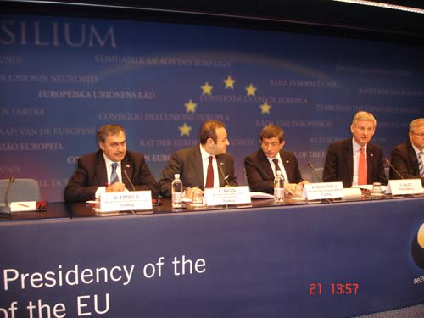
ENVIRONMENT CHAPTER
NEGOTIATION PERIOD
In 21 December 2009, ‘27 Numbered Environment Chapter’ is officially opened to negotiation at ‘Intergovernmental Accession Conference’ which held in Brussels.

Slide 5
ENVIRONMENT CHAPTER CLOSING BENCHMARK
Harmonization of Water Framework Directive, Preparation of River Basin Management Plans
Most of the legislations which are prepared in water sector, especially Water Law, are harmonized with EU acquis.
Notes:
5

Slide 6
No | Name of the Legislation | Explanation
1 | By-law on Protection of Water Basins and Preparation of River Basin Management Plans | Official Gazette, Date: 17.10.2012 – Number: 28444
2 | Natinal Basin Management Strategy Document | Published in 04.07.2014 dated Official Gazette.
3 | Circular on Ergene River Basin Protection Action Plan | Published as 13.06.2013 dated Prime Ministry Circular.
4 | Comminique on Establishment , Duties, Working Principles and Procedures of Basin Management Committees | 20.05.2015 dated and 29361 numbered Official Gazette
5 | By Law on Monitoring of Surface and Groundwater | 11.02.2014 dated and 28910 numbered Official Gazette
6 | By-law on Surface Water Quality | 30.11.2012 dated and 28483 numbered Official Gazette

Slide 7
WATER RELATED INSTITUTIONS IN TURKEY
Ministry of Forestry and Water Affairs
Ministry of Foreign Affairs
Ministry of Development
Ministry of Health
Ministry of Food, Agriculture and Livestock
Ministry of Science, Industry and Technology
Ministry of Culture and Tourism
Ministry of Transport, Maritime Affairs and Communication
Ministry of Energy and Natural Resources
Ministry of Environment and Urbanization
Irrigation Unions and Cooperatives
Universities,
Non-Governmental Organizations
Ministry of Interior
Municipalities

Slide 8
ORGANIZATION ACCORDING TO COMMINIQUE
ON ESTABLISHMENT, DUTIES,
WORKING PROCEDURES AND PRINCIPLES
OF BASIN MANAGEMENT COMMITTEES
WATER MANAGEMENT COORDINATION COUNCIL
(Ankara)
BASIN MANAGEMENT CENTRAL COMMITTEE
(Ankara)
BASIN MANAGEMENT COMMITTEE
(In the basin)
PROVINCIAL WATER MANAGEMENT COORDINATION COMMITTEE
(In the province)

Slide 9
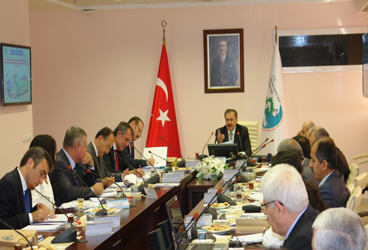
WATER MANAGEMENT COORDINATION COUNCIL
“Water Management Coordination Council” is established by 2012/7 numbered Prime Minister’s Circular

Slide 10
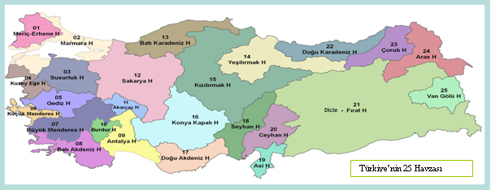
25 RBPAP HAVE BEEN PREPARED
Projects | Starting and Completion Date
RBPAP for 11 River Basins | 2009-2010
RBPAP for 14 River Basins | 2011-2013

Slide 11
ACTION PLAN STEPS
1
2
Updating the Environmental Infrastructure Status into GIS after Field Surveys
3
5
Calculation of Pollution Load
6
Main Environmental Problems in the Basin and Solutions
8
Follow up of Action Plan Work Schedule
Presentation of all collected data in GIS
Updating Actual And Potential Status of Water Resources
Updating the General Characterization of River Basins in GIS
7
Updating Urban Wastewater Treatment Plants Planning
4
Classification of Water Quality
9

Slide 12
ACTIONS
Action 1 Urban Wastewater Management
Action 2 Industrial Wastewater Management
Action 3 Solid Waste Management
Action 4 Diffused Pollution Management and Control
Action 5 Afforestaiton, Flood and Erosion Control
Action 6 Sludge Control
Action 7 Preparation of Basin Protection Plans in Drinking Water Basins
Action 8 Flood Management
Action 9 Drought Management
Action 10 Monitoring, Inventory and Water Information System Studies
Action 11 Water Investments
Action 12 Reuse of Treated Wastewater
Action 13 Control of Climate Change Impacts on Water Resources
Action 14 Sectoral Allocation Plans
Action 15 Solutions for Hotpoints

Slide 13
RIVER BASIN MANAGEMENT
PLANNING
Environmental Objectives
River Basin
District
River Basin
Charactrization
Significant Water
Management
Issues
Programme of
Measures
River Basin
Management Plan
Monitoring

Slide 14
RIVER BASIN MANAGEMENT PLAN
Chapters:
Description of the Characteristics of the River Basin
Summary of Significant Pressures and Impacts
Identification and Mapping of Protected Areas
Map of Monitoring Networks and Monitoring Programmes
List of Environmental Objectives
Summary of Economic Analysis
Summary of the Programme of Measures
Register of More Detailed Programmes
Summary of the Public Consultation and Information Measures and Resulting Changes
List of Competent Authorities
Contact Points for Background Information

Slide 15
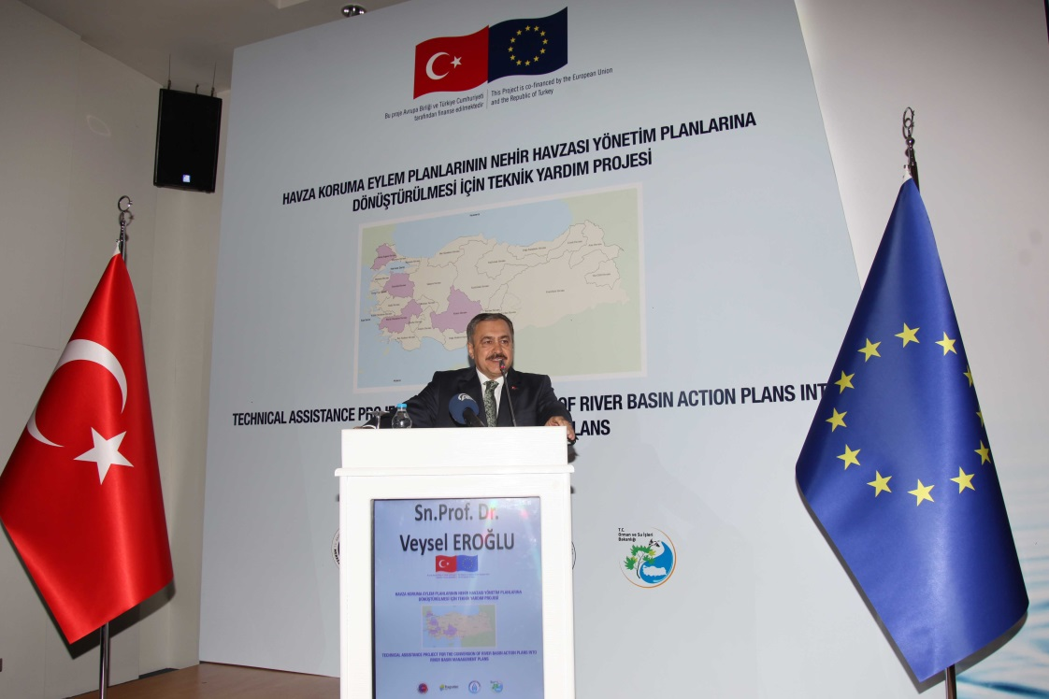
TECHNICAL ASSISTANCE PROJECT ON CONVERSION OF RIVER BASIN PROTECTION ACTION PLANS INTO RIVER BASIN MANAGEMENT PLANS
Project Duration:
2014-2017
Project Objective:
Conversion of river basin protection action plans into river basin management plans in accordance with Water Framework Directive and Daughter Directives and capacity building.

Slide 16
RIVER BASIN MANAGEMENT
PLANNING
It has started in 29 December 2014,
4 River Basin Management Plans are being prepared:
Büyük Menderes Basin
Konya Basin
Susurluk Basin
Meriç –Ergene Basin
Cooperation with Bulgaria and Greece

Slide 17
TECHNICAL ASSISTANCE PROJECT ON CONVERSION OF RIVER BASIN PROTECTION ACTION PLANS INTO RIVER BASIN MANAGEMENT PLANS
Characterization Report
Significant Water Management Issues
Monitoring Report
Environmental Objectives Report
Report on Programme of Measures
River Basin Management Plans
1
2
River Basin Management Plan
3
4
5
6

Slide 18
FUTURE PLANS
All River Basin Management Plans will be completed at the end of the 2020.
3 basins’ RBMPs and Economic Tools (in the pre-tendering phase)
1 basin’s RBMP (in the national investment programme) (2015-2017)
17 basins’s RBMPs (in the pipeline – IPA II. Period)
Implementation of RBMPs will start gradually

Slide 19
MINISTRY OF FORESTRY AND
WATER AFFAIRS
THANK YOU

